Slide 1

THE ROLES OF HEALTH INFORMATION SCIENCE STUDENTS IN COVID-19 PANDEMIC
PRESENTED BY
RAJABU M. SIMBA ( DIPL. HIS )

Slide 2
Presentation Outlines
Introduction Of Covid-19 Pandemic
Current Situation Of Covid-19 Pandemic
Health Information Science Course
The Roles of HIS in the Provision of Covid-19 Information
Impacts Of His Students In Combating Covid-19
Challenges Faced During Provision Of Covid-19 Information
Conclusion

Slide 3
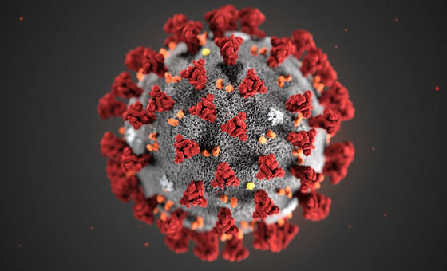

Introduction of Covid-19 Pandemic
The COVID-19 pandemic also known as the coronavirus pandemic is an going pandemic of coronavirus disease 2019 (COVID-19) caused by severe acute respiratory syndrome coronavirus 2 (SARS-CoV-2) .
The outbreak was first identified in Wuhan, china in December 2019. The WHO declared the outbreak a Public Health Emergency of International Concern on 30 January and pandemic on 11 march. (According WHO)

Slide 4
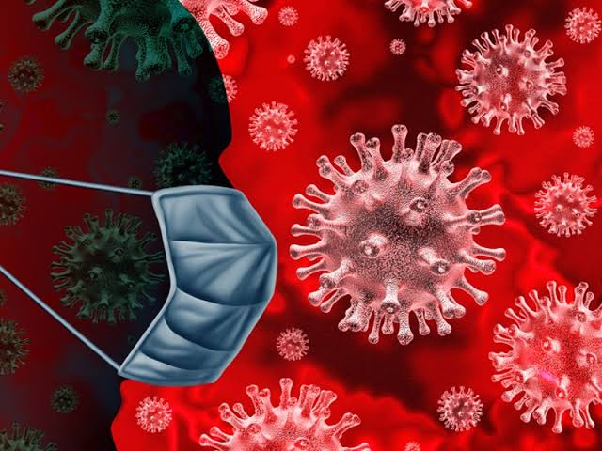
Current Situation of Covid-19
Transmission category
No cases: Countries with no confirmed cases (not shown in table)
Sporadic cases: Countries with one or more cases, imported or locally detected ( transmission occurs infrequently and irregularly)
Clusters cases: Countries experiencing cases, clustered in time, geographic location and/or by common exposures ( common source is suspected)
Community transmission: Countries experiencing larger outbreaks of local transmission defined through an assessment of factors including, but not limited to:
- Large numbers of cases not linkable to transmission chains
- Large numbers of cases from sentinel lab surveillance
- Multiple unrelated clusters in several areas of the country/territory

Slide 5
Data as received by WHO from national authorities by 10:00 CEST, 21 June 2020
 | TOTAL CONFIRMED CASES | TOTAL DEATHS | RECOVERED | TRANSMISSION CLASSIFICATION | DAYS SINCE LAST REPORTED CASE
GLOBAL | 8 708 008 cases | 461 715 deaths | 4,152,683 | ALL TRANSMISSION CATEGORY | -
AFRICA | 216 999 cases | 4 874 deaths | 110,735 | ALL TRANSMISSION CATEGORY | -
TANZANIA | 509 cases | 21 deaths | 183 | COMMUNITY TRANSMISSION | 44 Days

Slide 6

Health Information Science Course
The HIS program is a hybrid curriculum that encompasses multidiscipline including,
Health Sciences
HIV/AIDS and infectious diseases (eg. COVID-19 Pandemic)
Library and Information Sciences
Research Data And Health Records Management
General Health Informatics

Slide 7
Health Information Science Course
In 2017/2018 academic year HIS programme was started under Ministry of Health at CEDHA-TANZANIA
TWO Training institutions under the MoHSW are running the programme:
CEDHA – Arusha
Lake Zone Heath Training Institution – Mwanza
The total of 156 students in all institutions
Program Objectives
The program intends to train competent health information specialists with the skills to manage the changing landscape of Tanzanian and other developing nation’s health information needs.

Slide 8
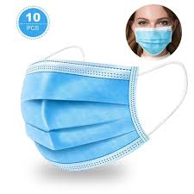
The roles of health information science students in the provision of covid-19 information
1. Promote strategies for prevention of COVID- 19 Pandemic by creating and disseminating information relating to preventive measures of COVID-19 Relevant to
General instruction on
(A) Masks
When needed
How to put on
How to remove

Slide 9

The roles of health information science students in the provision of covid-19 information
(B) Hand washing
How do I wash my hands properly?
How long should I wash my hands for?
When should I wash my hands?
Those general instruction disseminated by using Video Based Lecture, Social Media, blogspot, website, online health consultation, Health Learning Materials

Slide 10


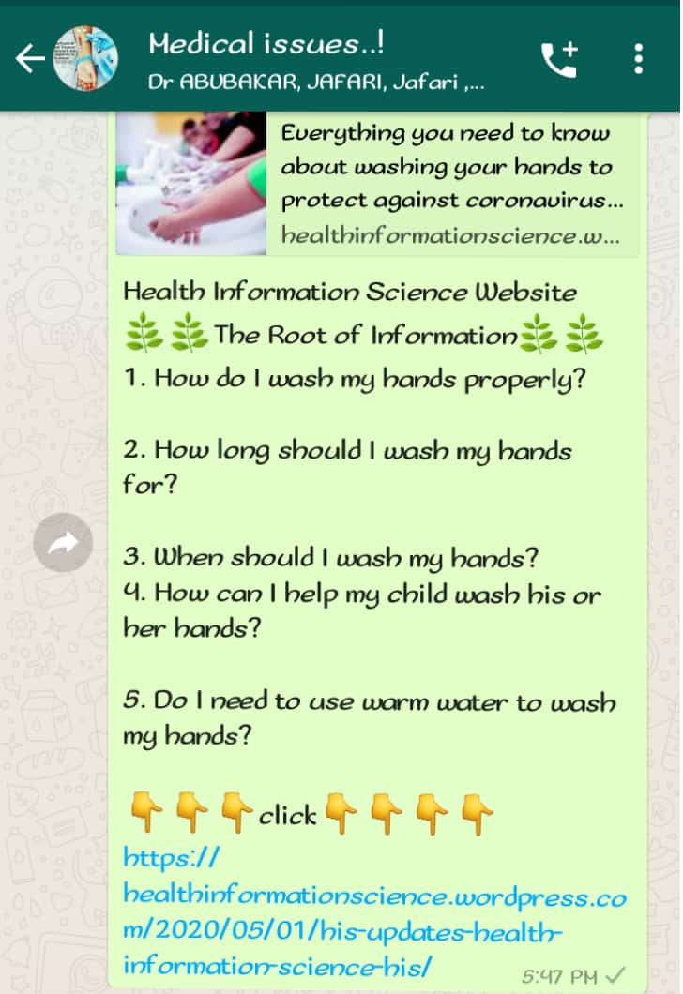
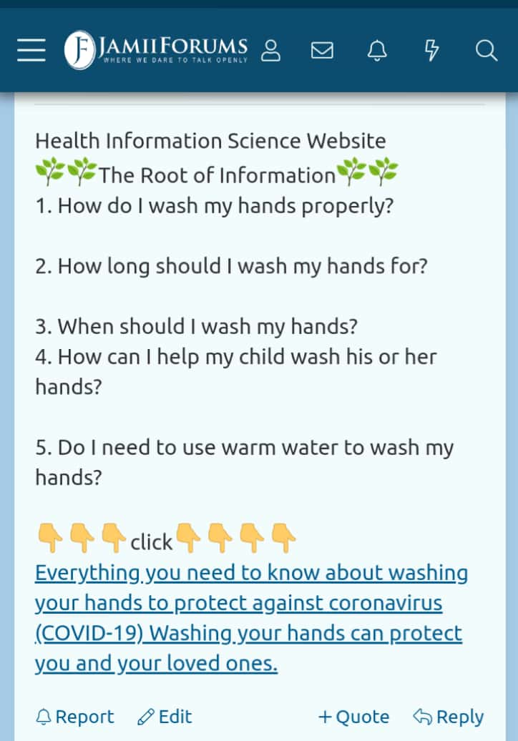
A) Social Media

Slide 11


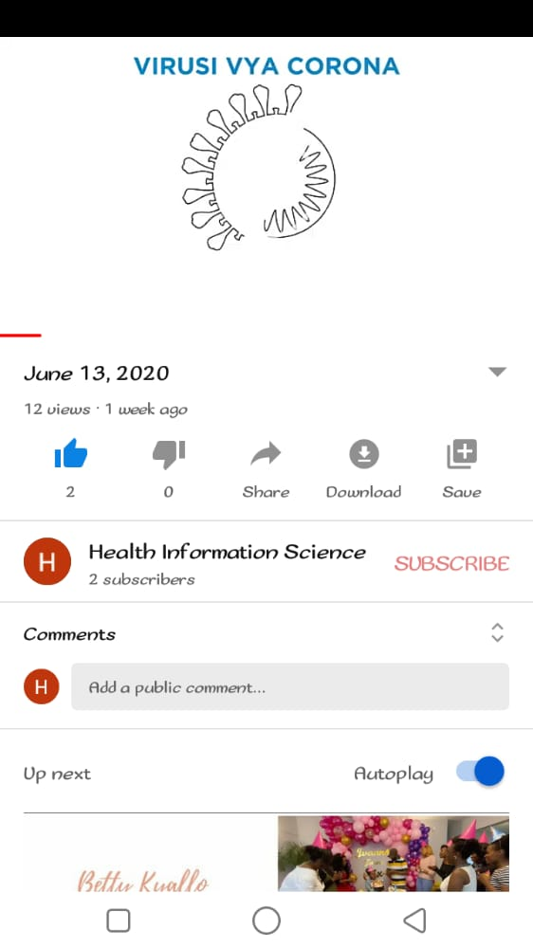
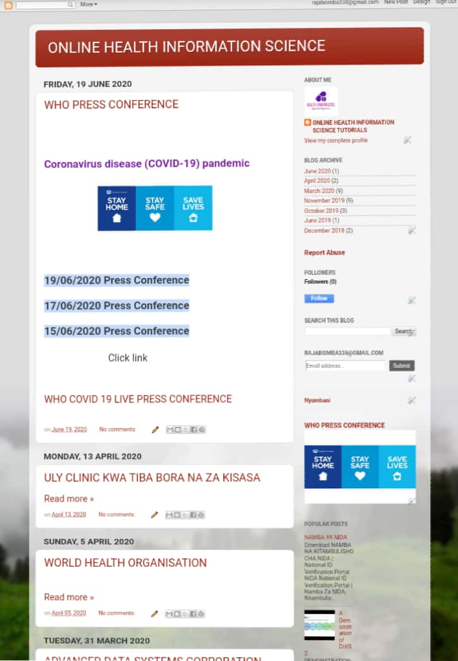
B) video based lecture C) blogspot

Slide 12


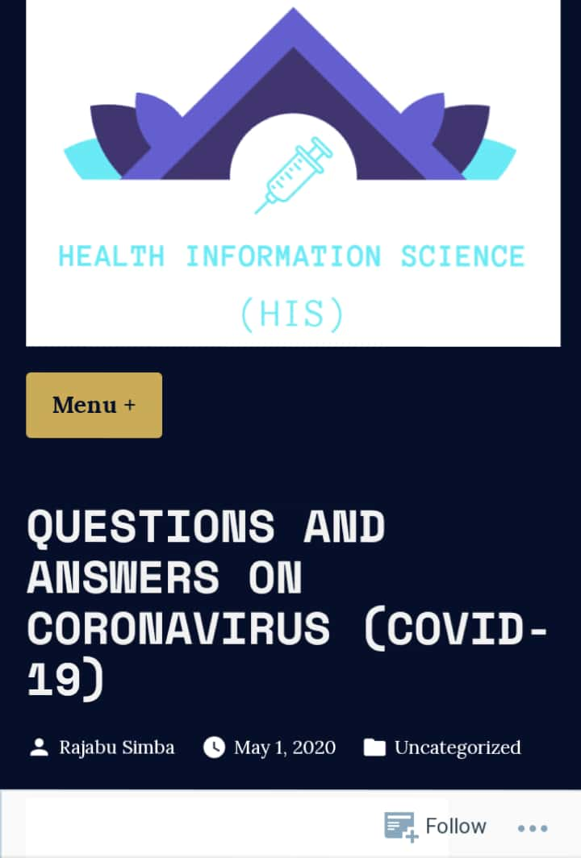
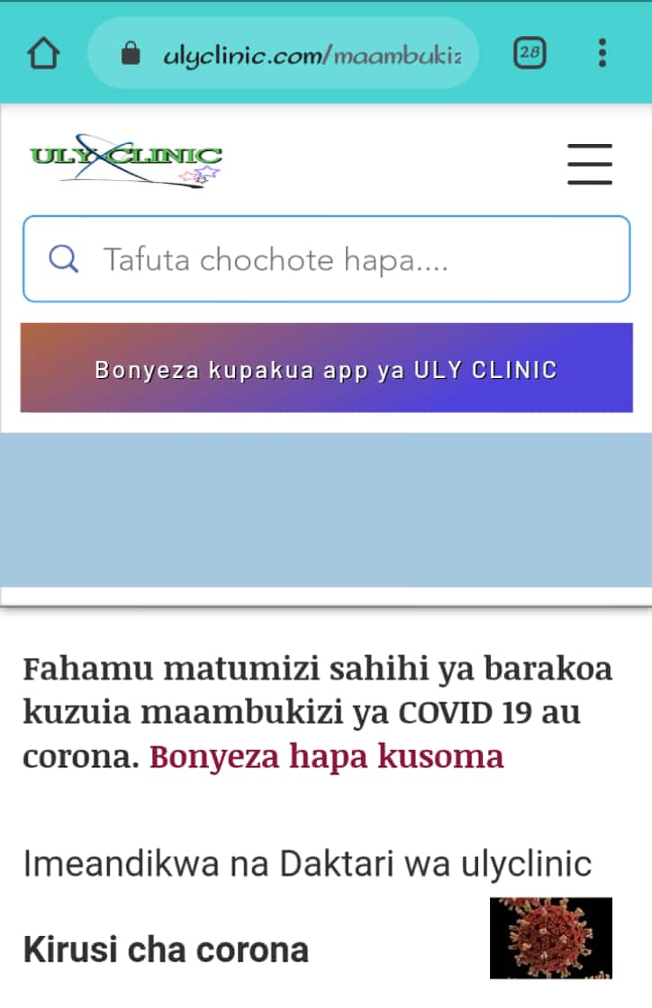
D) website E) online health consultation.
(healthinformationscience.wordpress.com)

Slide 13

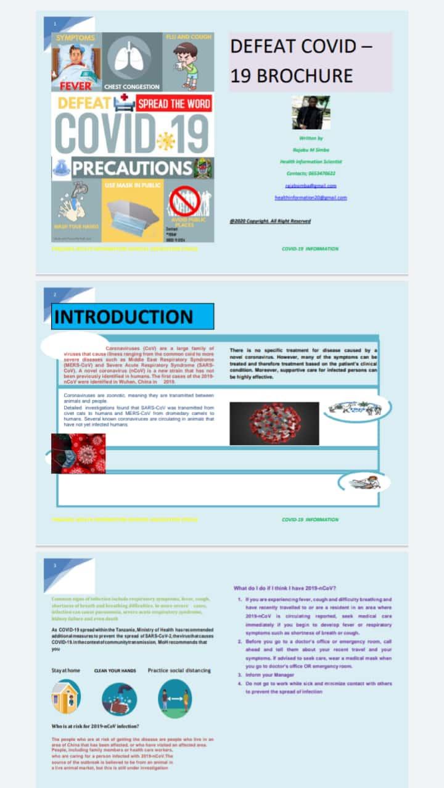
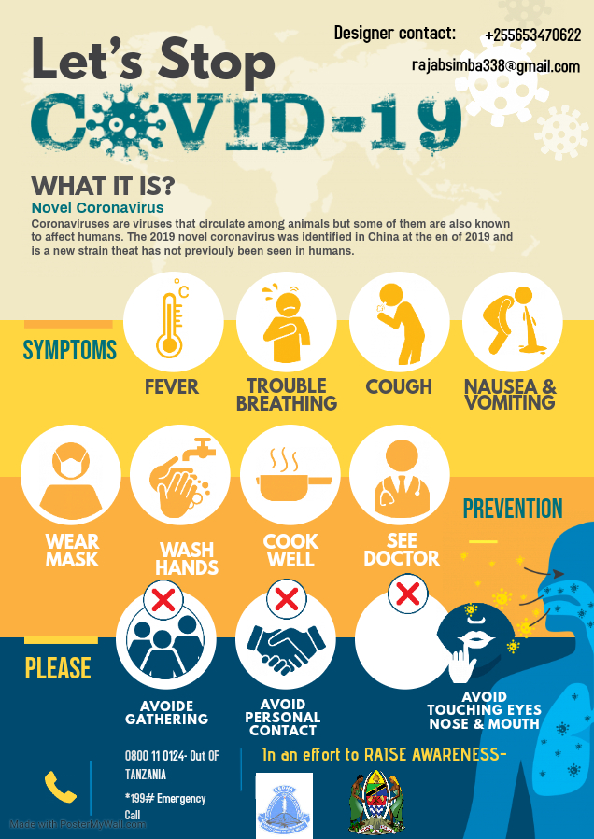
F) Health Learning Materials 1. Brochure- DEFEAT COVID-19 2. Flyer

Slide 14
The roles of health information science students in the provision of covid-19 information…….continue
2. Provide Support to the
Research teams in
Drawing attention to the latest research and evidence information about COVID 19
Provision of references
Delivery document related to infectious Diseases

Slide 15
The roles of health information science students in the provision of covid-19 information……continue
B) Medical staffs in
Provide health information needs for evidence based decision making such as in clinical literature searches on etiology, prognosis, diagnosis and therapy of diseases and diagnostics.
Provide access to vital information to the health care like number of COVID-19 Patients
Provide life saving information for the patient care like materials ranging from traditional print source to electronic database

Slide 16
The roles of health information science students in the provision of covid-19 information………continue
C. Academic Faculty in
Provide instruction about COVID 19 information and consultation services through brochures, flyers, published papers, HIS website
Host strategies and Measures of COVID 19 prevention such as uly clinic website
Provide early MEDLINE and information skills training to students in the class about COVID 19 Pandemic

Slide 17
The roles of health information science students in the provision of covid-19 information……continue
By using free Databases provide Medical Journals Such as electronic resource Publishers
Elsevier
Wiley Online Library
Research 4life
NLM-NIH
HINARI

Slide 18


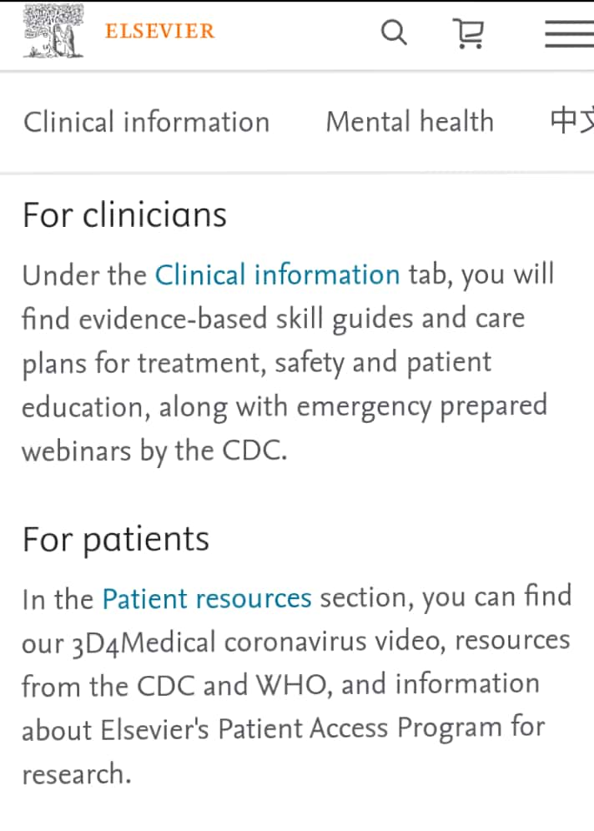
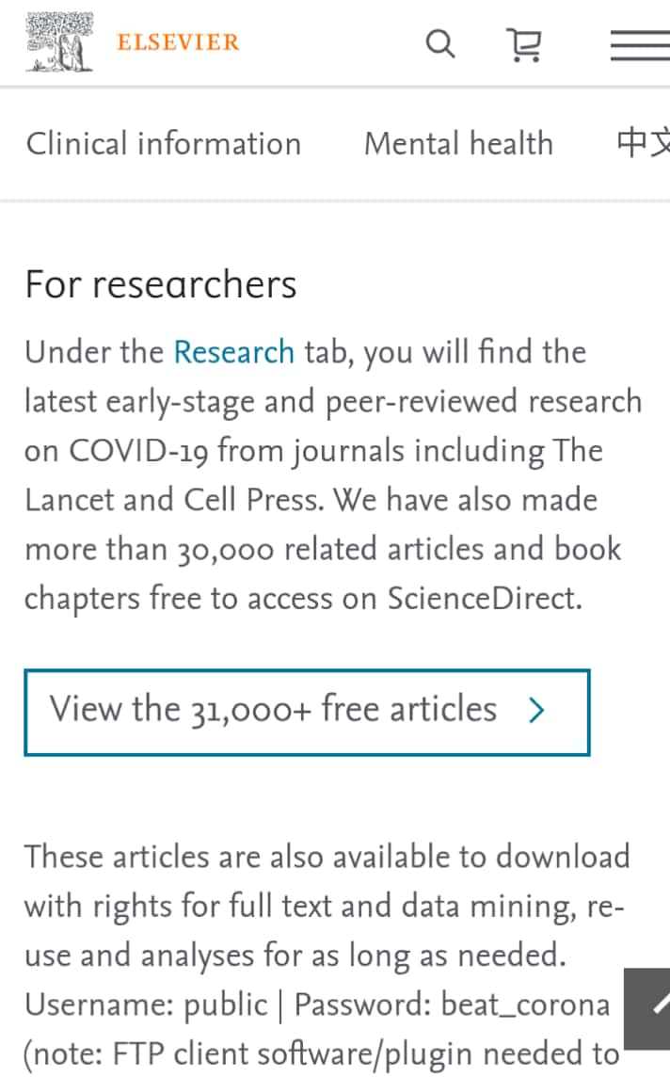
A. Elsevier
Provide curated information for the research and Health Community on SARS-COV-2 ( the novel coronavirus) and COVID-19 ( the disease) https://www.journals.elsevier.com/journal-of-critical-care/covid-19
All resources are free to access and include guidelines for clinicians, researchers and patients journals

Slide 19

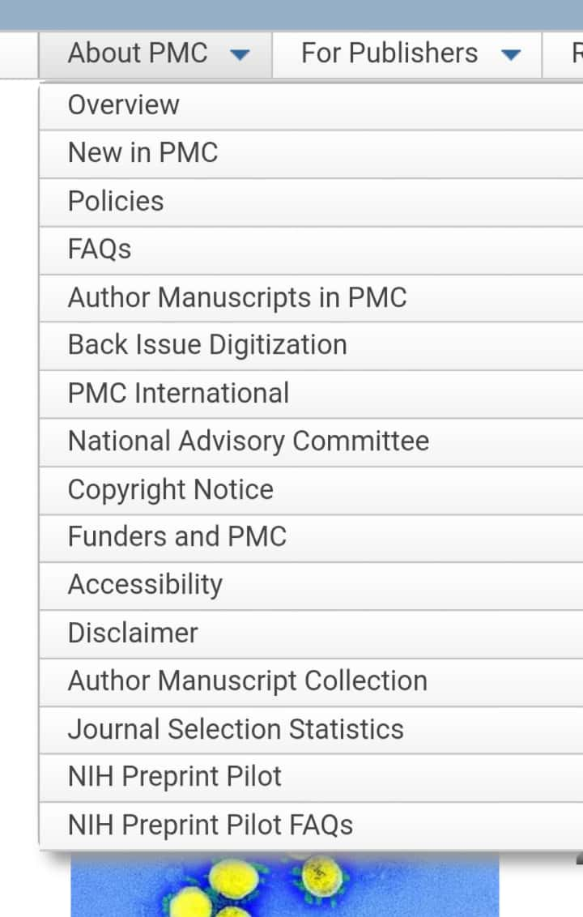
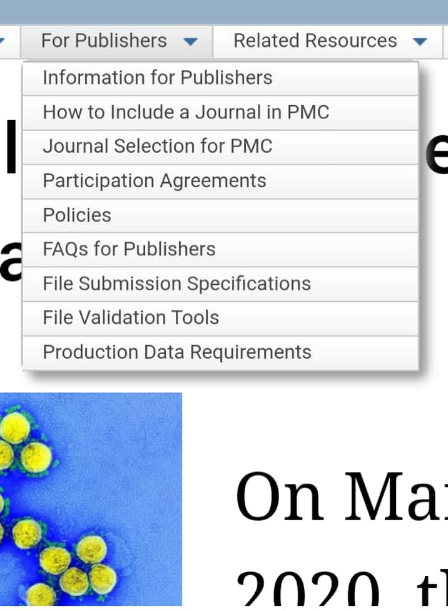
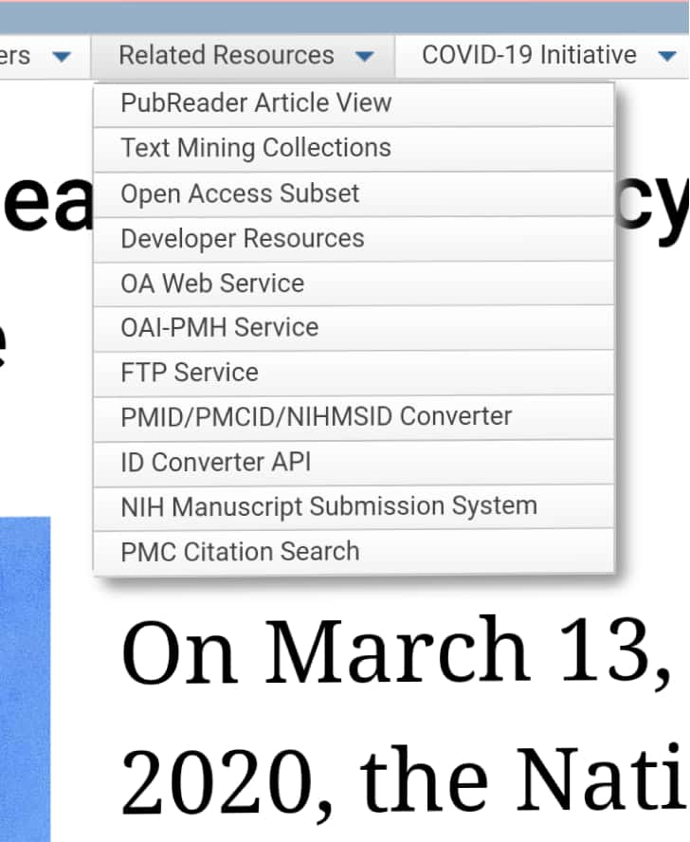
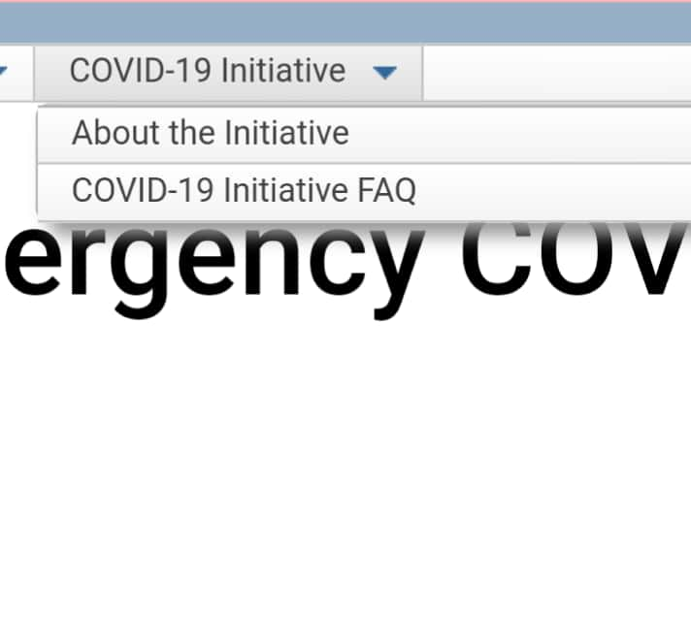
B. NLM/ NIH
NLM/NIH- Publishers to voluntarily make their COVID 19 and coronavirus related publication and available data supporting them, immediately accessible in PubMed Central (PMC). The Features are https://www.ncbi.nlm.nih.gov/pmc/about/covid-19/

Slide 20
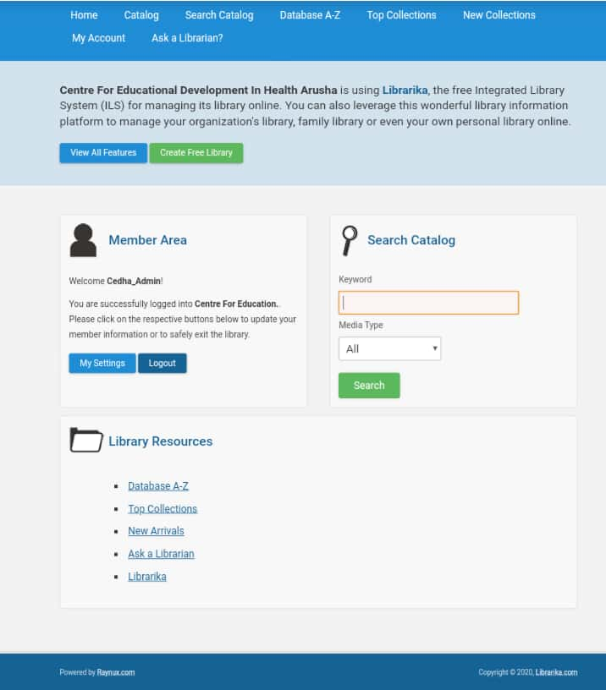
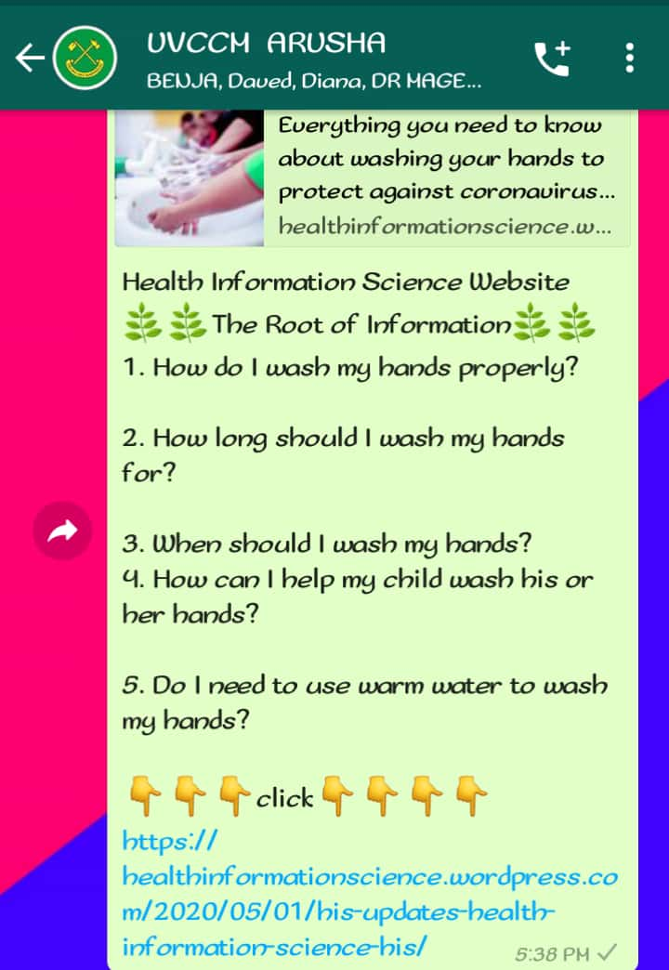
The roles of health information science students in the provision of covid-19 information…continue
3. Change traditional services to online health information services by using Online Library system (cedha.librarika.com) Skype or Zoom, Online Health Information science BlogSpot, HIS Website. Relevant to
Provision of references
Document delivery
Literature searches
Systematic reviews

Slide 21
The roles of health information science students in the provision of covid-19 information…..continue
4. Frequent transparent communications with the public and strong community engagements in Keep up to date information about COVID-19 by using flyers, brochures
1. Brochure- DEFEAT COVID-19 2. Flyer- Lets Stop COVID 19

Slide 22
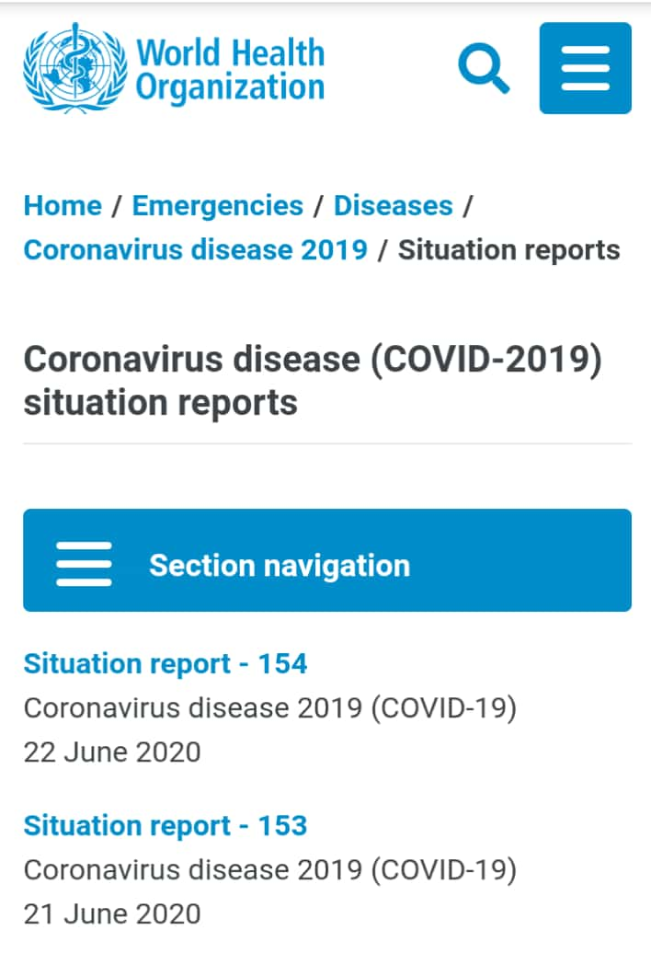
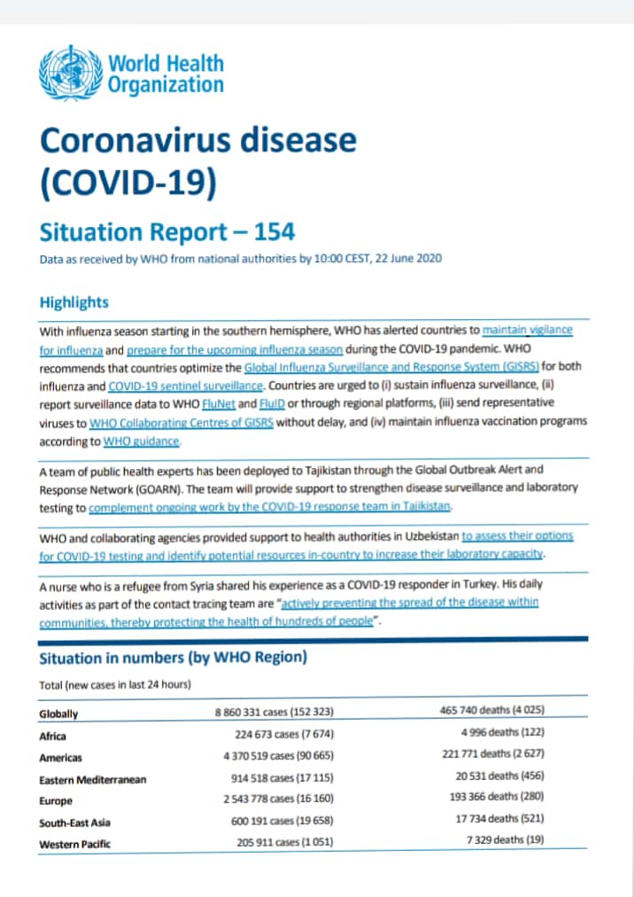
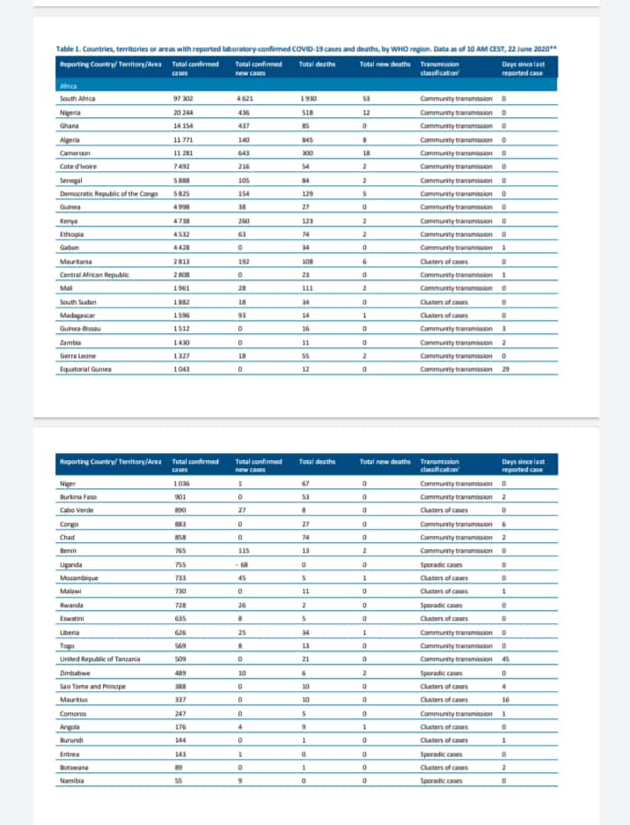
The roles of health information science students in the provision of covid-19 information….cont
5. To assist in surveillance and rapid response to COVID 19 threats by using COVID-19 outbreak Surveillance systems throughout emerging database such as WHO daily reports, Medscape COVID 19 alerts

Slide 23
Impacts of HIS students in combating covid-19
1.Increase Public Awareness about COVID-19 Symptoms, cure, and possible measures to avoid pandemic , through online health information science (rajabsimba.blogspot.com), HIS website (healthinformationscience.wordpress.com)
2.Increase number of Viewers who access website (healthinformationscience.wordpress.com)
3. Getting COVID 19 update information at right time about COVID 19 Pandemic to the students, medical staff, paramedical staffs.

Slide 24
Impacts of HIS students in combating covid-19
4. Reduction of COVID-19 infections through the power of relevant information through
HIS YouTube channel
HIS website
WHO information Website
5. Reduction of social and physical contacts through education provided from
social media, online Health Learning Materials
information channel, video based lectures
Electronic resources

Slide 25
Challenges faced during provision of covid-19 information
1. Information illiterate for the users of COVID 19 information. Example users fail to search relevant information within website
2. False information on current situation from unreliable sources or Websites about COVID 19 Pandemic
3. Shortage number of followers and subscribers on YouTube channel and website-User afraid to Access COVID 19 information (believe that when access information about COVID 19 may increase anxiety, stress, depressions)

Slide 26
Challenges faced during provision of covid-19 information
4. Lack of internet access on information searching and retrieval of COVID 19 information
5.Time consuming - it takes too much time on searching information by study current journals, articles from relevant COVID 19 website Example. Hong Kong COVID 19 track called Stay home stay safe website

Slide 27
CONCLUSION
Health information science students can play vital role to disseminate the information with the health care workers, society, and community
Access to the Internet and digital technologies during the coronavirus pandemics, can be a lifesaver for the many people around the world. Information of COVID 19 Pandemic can be access from
Electronic resources (Medical journals)
Video Based Lecture ( YouTube channel)
Social Media ( WhatsApp, Facebook, Instagram, Jamii Forum)
Mobile Apps ( COVID-19 Apps)
Information sites and Channel (BlogSpot, websites)

Slide 28

THANK YOU
STAY ALERT, CONTROL THE VIRUS, SAVE LIVES OR STAY HOME

